Slide 1
CM2015: Programming with data
Group 5

Slide 2
Tokenization
Splitting up a larger body of text into smaller lines, words or even creating words for a non-English language.

Slide 3
Lemma
Stemming and Lemmatization are text normalization (or sometimes called word normalization) techniques in the field of natural language processing that are used to prepare text, words, and documents for further processing.

Slide 4
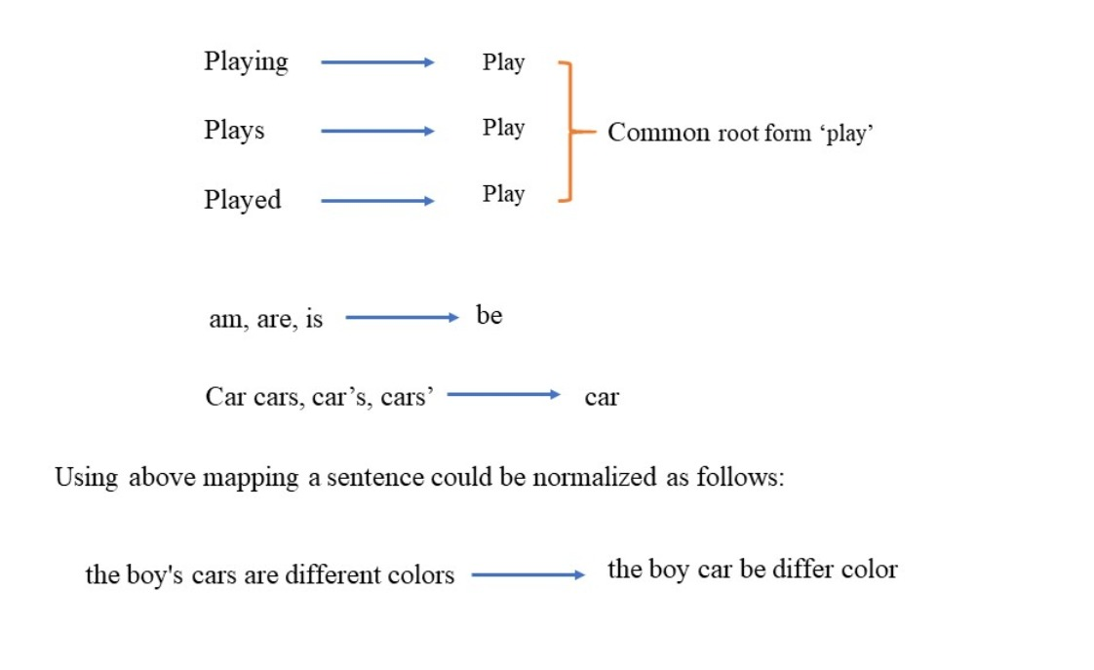
Lemma (con’t)

Slide 5
Frequency distribution
Graphical representation of a number of distinct values and how often they occur.

Slide 6
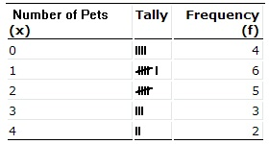
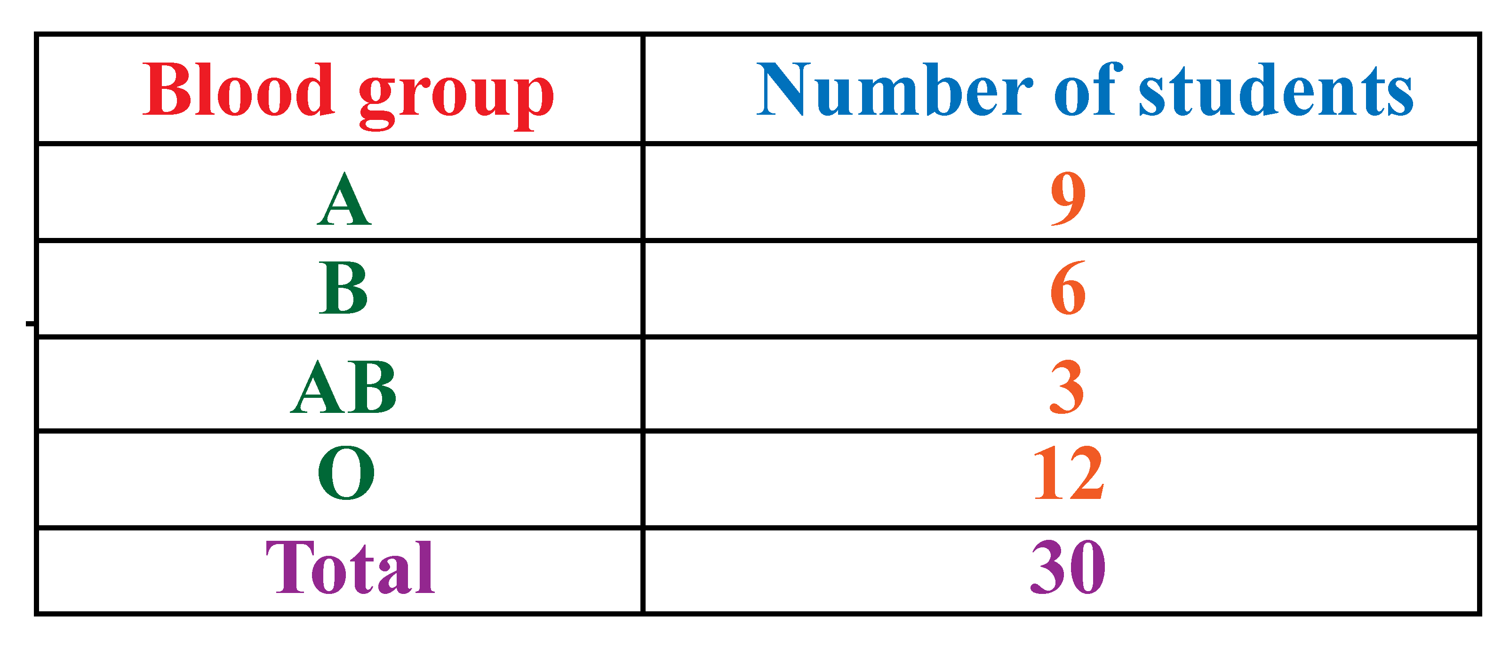
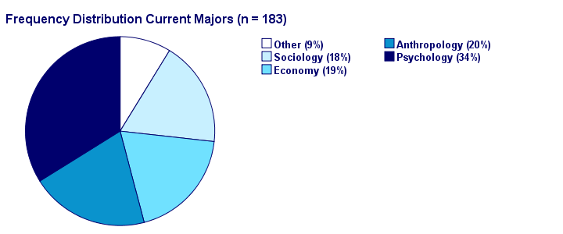
Frequency distribution (con’t)

Slide 7
Word cloud
A word cloud is a collection, or cluster, of words depicted in different sizes. The bigger and bolder the word appears, the more often it’s mentioned within a given text or the more important it is.
Common library used: “wordcloud”
TLDR: word cloud = visual representation of words from a given text dataset, size of words = frequency or weight.
Common use cases: Sentimental Analysis, for e.g. a business trying to find out what people are tweeting about their products.

Slide 8
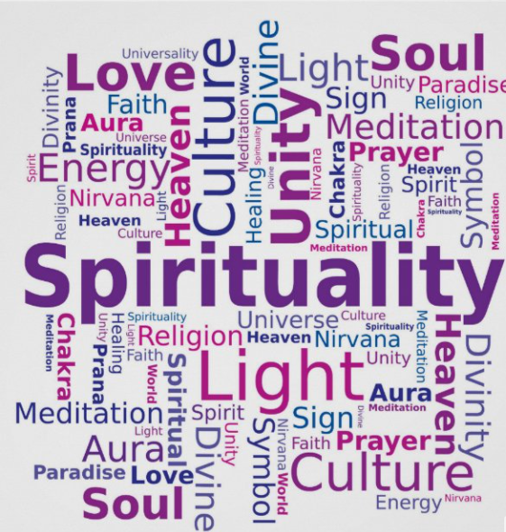
Word cloud (con’t)

